Slide 1
Container Orchestration
Part 1

Slide 2
What is container orchestration?
VMware: the automation of much of the operational effort required to run containerized workloads and services.
RedHat: automates the deployment, management, scaling, and networking of containers.
IBM: automates the provisioning, deployment, networking, scaling, availability, and lifecycle management of containers.
AVI networks: he automatic process of managing or scheduling the work of individual containers for applications based on microservices within multiple clusters.
Google: automatically provisions, deploys, scales, and manages containerized applications without worrying about the underlying infrastructure.
AWS: …
→ They didn’t bother to come up with any explanation :)))

Slide 3

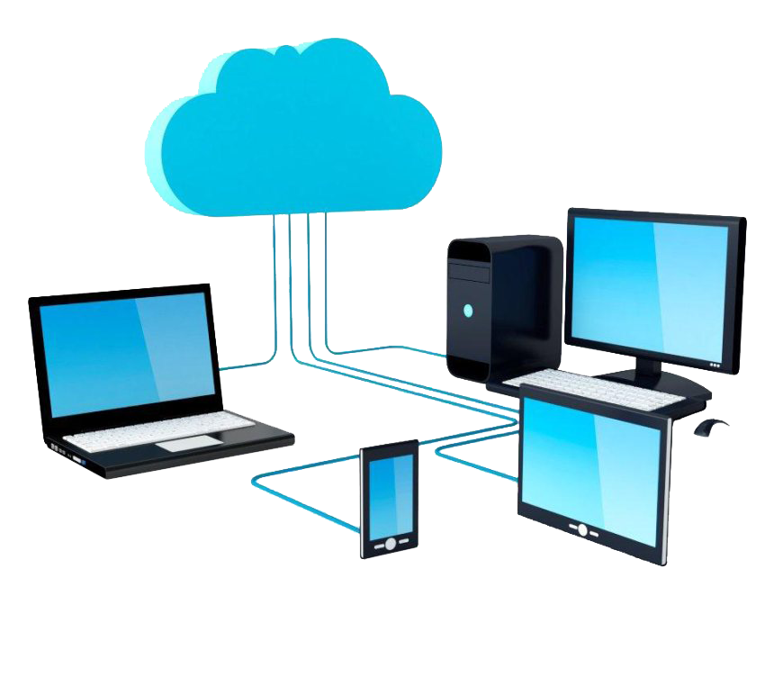
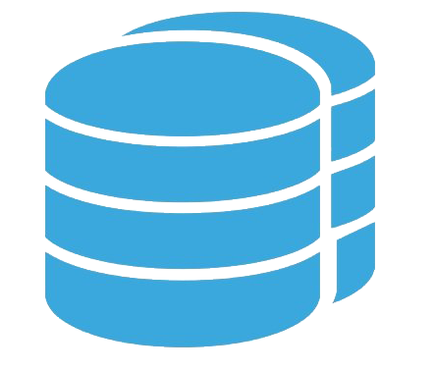
What is container orchestration? My version
There are 2 sides here
Resource Management
Container Lifecycle
Container orchestration handle all of these
Running
Creating
Stoping
Scaling
Deleting
...
Notes:
Resource management → We’re not involved in managing these for containers. One time setup, then just using:
Resource pool
Different kind of hardwares
Storage
Network
…
Container lifecycle: There are a lot of states here. We just tell the orchestration what we want, it handle all of these states.

Slide 4

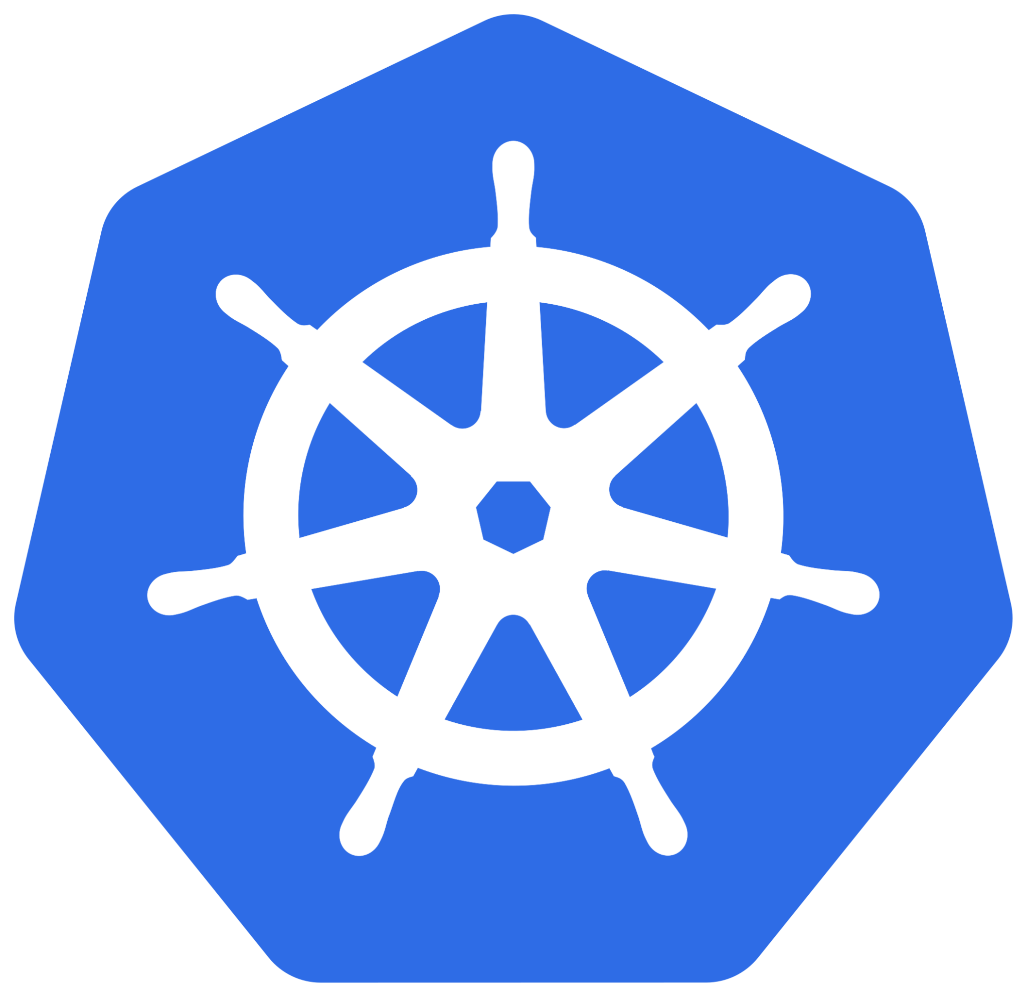
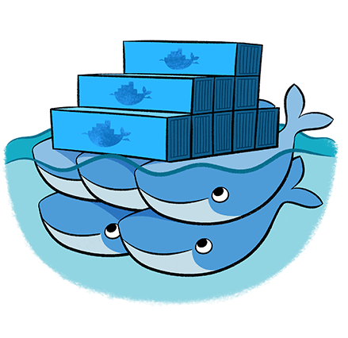
Kubernetes vs Docker swarm
Let me do the most fair comparison that ever existed
That’s it. If you think, K8S is big for you, then you can say that you don’t probably need container orchestration.
Don’t fool yourself :)))
Kubernetes
Docker swarm

Slide 5
Kubernetes

Slide 6
Architecture
To understand why a service has a specific architecture, first we have to understand what is the requirements for that service:
Something to handle client interactions
Something to handle containers for each node
Something to manage each node
Something to handle required network rules for each node
Something to handle/translate client requests for cluster
Something specify where to put each service
Something to manage the cluster
Something to keep any data related to cluster
Something to handle other aspect for cluster like network
So we need a whole bunch of SOMETHINGs

Slide 7
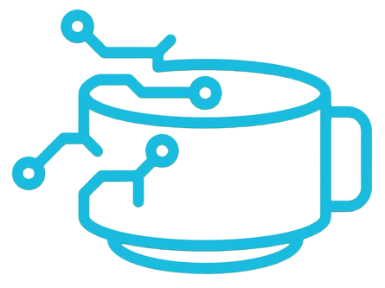
Architecture
Let’s break this down to more related parts
Refer to “Container” slides to get the answer
SOMETHING
It seems that there are some heavy lifting about managing the cluster
Do we really using Docker?
Client
Cluster network
Each node
Cluster management
kubectl
Something to handle/translate client requests for cluster
API Server
Something to handle client interactions
Scheduler
Something specify where to put each service
Something to manage the cluster
Something to handle containers for each node
Controller Manager
Docker
Something to keep any data related to cluster
Something to manage each node
etcd
kubelet
Something to handle required network rules for each node
kube-proxy
Something to handle other aspect for cluster like network
Addons
Notes:
We do really install Docker, but like we talk about it in “Container” section, K8S will use Containerd which is CRI compatible.

Slide 8
Architecture
Since there are good amount of cluster management requirement, It’s a good idea to have dedicated resources for them
kubectl
Controller
Worker
Docker
API Server
kubelet
Scheduler
kubectl is a cli tool which gets user input in a user friendly fashion and send them to related components of cluster to be executed; like what we had for docker cli
kube-proxy
Controller Manager
API Server
etcd
Scheduler
kubelet
kube-proxy
kubelet
kube-proxy
Controller Manager
Docker
Docker
etcd
Addons
What about kubectl & Addons?
Notes:
If you think cli is not user friendly, you’re in a wrong business :)

Slide 9
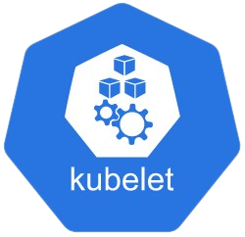
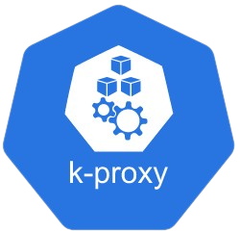
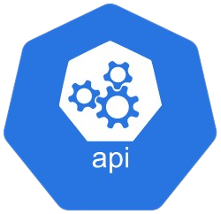

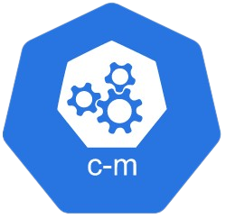
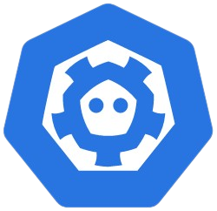
A little bit of interrupt
If you want to deep dive about each component that we mentioned, please read this section of K8S documentation, called Concepts.
If not, this part of above documentation, is a MUST read section: Kubernetes Components
kubelet
kube-proxy
API Server
Scheduler
Controller Manager
etcd
We also bundle cluster management components and called them control plane

Slide 10

Architecture
Scheduler
Controller Manager
etcd
Client
(e.g. kubectl)
Control space
Control plane
API Server
kubelet
kube-proxy
How communication works?
Which component talk to which component?
IPtables / IPVS
Node space
Notes:
Although each components has its own unique responsibility, every communication go through API Server since this component is the cluster frontend;
For example Controller Manager check each node health periodically by checking with each node boss (kubelet) but the communicate via API Server.
Each component may use some OS or kernel functionality but this is in its own responsibility space; for example, kube-proxy uses owr own “IPtables” to set required rules on each node/host

Slide 11
Recap
There are several components that we need to create a K8S cluster:
kubelet
kube-proxy
API Server
Scheduler
Controller Manager
etcd
There are some required components as well like “kubectl” and Addon which we will discuss later
Since there are good amount of cluster control related components and since they have a mission critical roles, It’s a good idea to group them in something called “control plane” and deploy them in a separate node which usually called “Controller Node”
Every single component call “API Server” to communicate with others since this component is the frontend for cluster
Each component may use OS or kernel functionalities as the need; e.g.: kube-proxy → IPtables
Client uses a tool called “kubectl” to interact with cluster; again through “API Server”
All communication through “API Server” are encrypted and required certificate to prevent known vulnerabilities like man-in-the-middle-attack and avoid unauthorized access to any part of cluster

Slide 12
Cluster
Why do we need to create a cluster?
OK, we will create a controller node to have dedicated resources and bunch of worker nodes to cover required resources
But why cluster?
To answer this, we need to understand what issue(s) we’re trying to fix via cluster

Slide 13
Break Time

Slide 14
Cluster: Issues of single node
Single point of failure
If there is only one of each component, there will be none component in some point
We need high availability → HA
High load
If load increases, we have to scale the component
Scale up → Add more resources to our existing component
There are other software components that this will not resolve (e.g.: thread management)
Scale out → Add more component as same as existing component and balance the load
We need load balancing → LB
Is there any issue which created by having cluster?
100%; everything is trade-off
e.g.: Split-brain

Slide 15
Cluster: Which components needs HA & LB
kubelet
kube-proxy
API Server
Scheduler
Controller Manager
etcd
Each node has one these since these components are in node space
These components needs HA & LB to secure the functionality of cluster management since they are in control space/plane
OK, we understand that we need both HA & LB for these components, but how many of each components are required?

Slide 16
Cluster: How many of each component?
To answer this, we need to go back to the requirements that these components created to satisfy
API Server: to handle/translate client requests for cluster
a.k.a.: cluster frontend
Scheduler: specify where to put each service
Controller Manager: to manage the cluster
etcd: to keep any data related to cluster
a.k.a.: a key-value store for cluster
Holy number → 3
WHY?
Why not 2? It seems enough
These are stateless ⇒ We can have as many component as we need to handle our load (management load)
This uses RAFT protocol ⇒ We have to honor the requirements of this protocol
Notes:
For all of them except “etcd” 2 node is enough. More node just create additional layer for HA & LB.
“as many component as we need” is not a right term and scaling, like any other things, has its benefits & drawbacks.
Since we have to have at least 3 nodes to setup an etcd cluster, we use the same nodes for all control plane components but we don’t have to do this for them.

Slide 17
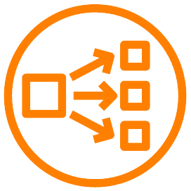
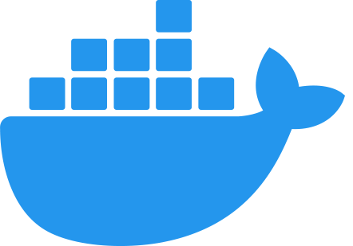
Cluster Architecture
Which one should we send our requests to?
Controller 1
Controller 2
Controller 3
Worker 1
Worker n
…
3 node Cluster
We will talk about what will happen if we want to create some sort of resource in such cluster in the next session
Notes:
Since every component is stateless and everything stores in etcd, there is no different.

Slide 18
Buckle up!
This will get a little confusing but remember that from this section forward, we’re going to just introduce some other parts of K8S, to be able to help you to complete the task and we will cover all of these in details in the next lesson
These are not important and I want you to understand that you SHOULD NOT focus on them, since we don’t need them for now and it just distract you from this section goal which is to understand how K8S cluster itself works

Slide 19
K8S’s yaml files
Something like docker-compose.yml files
K8S has different kind of resources which we will discuss them in the next session
These resources has their own unique mechanism to deploy services
For now, we just need to know that we need them to bring required services up on our cluster

Slide 20
Interaction with K8S: kubectl
Something like docker-cli
We use this to interact with our cluster
For now, just remember these:
kubectl get pods
kubectl apply -f <SOME_FILE>.yaml
kubectl delete -f <SOME_FILE>.yaml
For all of the above commands, you can add bellow section to interact with cluster in specific namespace which we also will talk about in the next session:
-n <SOME_NAMESPACE>
--all-namespaces
e.g.:
kubectl get pods -n kube-system
kubectl get pods --all-namespaces

Slide 21
Addon
There are some other functionalities which are required by K8S
These addons maintains by third-parties, not K8S itself
Some of them are mandatory to completes K8S functionality (somehow)
lists some of the available addons:
Networking and Network Policy → CNI
Service Discovery → CoreDNS
Visualization & Control
Infrastructure
Mandatory
Mandatory
To understand this, we need to understand how K8S networking works
And to understand K8S networking, first we need to understand how K8S behave and how we can deploy our applications on it
We will cover this in the next lesson; for now, just know that we need these

Slide 22
Mandatory Addon: CNI
To fully understand this section, we have to know about K8S’s networking; for now just accept that we need this to handle K8S’s pods.
Pods are the smallest section of K8S; we will cover this later, sorry :)
Just know that you have to choose some sort of CNI to make your cluster works.
I recommend something simple like Flannel.
See these URLs for available options:
Installing Addons | Kubernetes
GitHub - CNI - the Container Network Interface

Slide 23
Mandatory Addon: CoreDNS
Although this service listed as “service discovery” but it’s not a full service discovery application.
It provide an in-cluster DNS for pods.
This way we can use the name of our applications to call them.
This service will get the first IP of our cluster.
Same as before, we have to understand the K8S’s networking to understand this :)
Sorry about all the confusion but we have to know the essentials to move forward with our task

